Slide 1

Varun Kaushik Training : CLOUD COMPUTING WITH IBM CLOUD “HARDWARE HUB”
5th semester Shift 2 Enrollment No : 02021402019

Slide 2

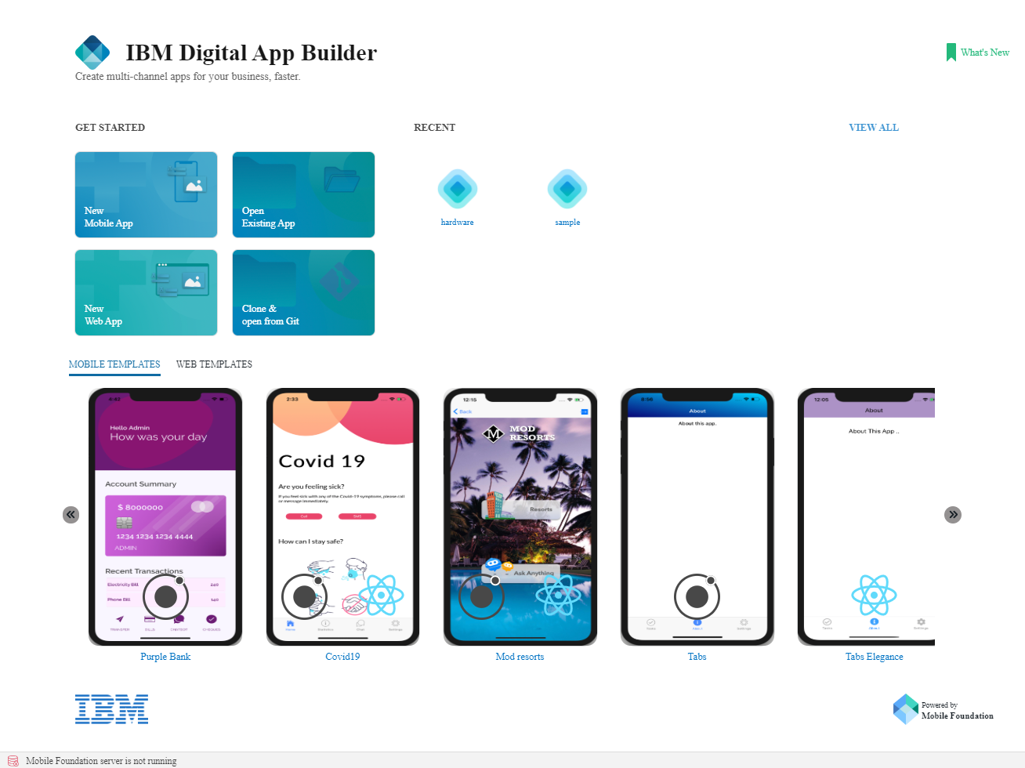
IBM DIGITAL APP BUILDER
IBM Digital App Builder is a low-code tool/software, which helps to quickly create mobile, web and PWA (Progressive Web App) multi-channel applications with AI capabilities powered by Watson services. It has two framework Ionic/Angular (open source -SDK)and React Native(front-end Java Script Library).
Quickly build digital apps and have templates which you can use in your project that can run on multiple channels. The Digital App Builder provides the ability to drag-and-drop components to quickly build an app. This app can be targeted to multiple channels, like apps for iOS (iPhone, iPad), Android (Phone, Tabs), Progressive web apps (PWA), and web pages.
Easily integrate Watson AI capabilities like Chatbot and Visual Recognition. Adding a chatbot or visual recognition capabilities to the app becomes as easy as adding a control. Also easily train the AI service by adding a set of questions and answers.
Add datasets and Live update that show/hide controls and pages or change their properties when your app is live.

Slide 3



Hardware Hub
Objective/Aim : This project main objective is to develop an app for Hardware Component i.e. for ‘Graphics Processing Unit (GPU) of the computer.
The app let us know the users what the best hardware GPU for them in their budget. By using this app you can check best GPU for your system as per your requirements.
From this app you will get to know about the exact prices of the GPU’s available in the market.
In our app you can also use our AI Hardware Bot, by using this bot your queries will get solved. You may ask any question regarding the hardware like is it available in the market or not. Our users of HARDWARE HUB will get faster updates. Our app is user – friendly, easy to use.

Slide 4

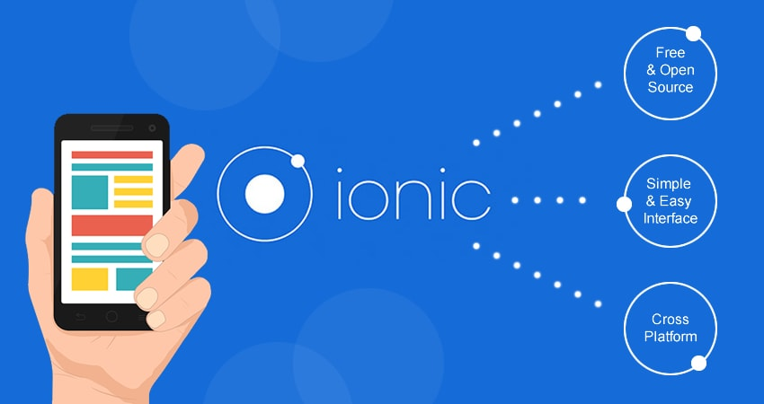


Technical Details
The app is made on IBM Digital App Builder with Ionic/Angular framework, channel as Android with design (no code). The app has many services connected like Watson Assistant, Cloudant Service. And have login control so that the user can login into the app. In Watson Assistant service the ‘Hardware Hub’ bot is made which solves the queries of the users of our app.
The Watson Assistant Service has a AI bot which will answer the questions of the users. Users can ask any query related to computer component GPU. The Watson Assistant Service is created on IBM cloud.
In Cloudant Service the database for GPU’s is made where user can check what are the best GPUs available in the market and which of them provides best performance and value for money by checking the description of every GPU mentioned in the app. The Cloudant Service is created on IBM cloud.

Slide 5

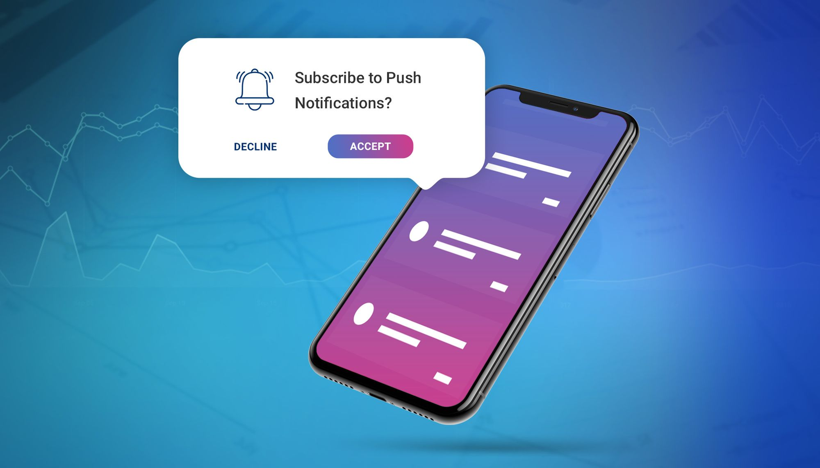

Technical Details (Cont.…)
The Login Control in the app will allow the users to login into the app. And that login will redirect the users to Buttons or What we have section where the user will see following buttons : Hardware AI Bot. Database of GPUs, Best GPUs available, From where you can buy and About Us.
The Username and Password is Admin.

Slide 6

Innovativeness & Usefulness
Users using our app will get latest faster updates about the GPUs in the market.
Which is the best GPUs as per their budget in the hardware market.
From where the user can buy various GPUs and on what price the component is available on different online selling partners.
App is easy to use it has buttons which will redirect our users to different pages.

Slide 7

Working Methodology
When the user first opens the app, home screen appears where a Login Control is there for logging into the app. The User Name and Password is as admin. On the top left hand side is the app name : Hardware Hub. When the user logs in he gets redirected to ‘buttons’ page that tell the users what we have where following buttons are available to him : Hardware AI Bot, Database of GPUs, Best GPUs available, From where you can buy and About US.
Now the first button is ‘Hardware AI Bot’ when the user clicks on this button he is redirected to Watson Page where the queries of the users will be answered. He can ask about what gpu is best for him in different price ranges or what gpu he wants to buy is it available in the market or not.
The second button is ‘Database of GPUs’, when the user clicks on this button he see many GPUs which are available in the market and can check their description and prices by clicking on them.
Third button is ‘Best GPUs available’, this button redirects the user to Market Page where the list of best GPUs is there in the month of July 2021. At the bottom of the page More button is there.
Now when the user clicks on the ‘More’ button he is redirected to another page named Comparison where there is comparison between DDR4 vs GDDR5 memory and DDR5 vs GDDR5 vs GDDR5X vs GDDR6. At the bottom there is a button of Difference between GTX and RTX Nvidia GPUs series.
When the user clicks on the ‘Difference between GTX & RTX series’, there is point wise difference and references link is given from which user can get more information and knowledge about the GPUs. At the bottom of the page there is a button named Amd Vs Nvidia.
The ‘Amd vs Nvidia’ page shows the differences between both the GPU providers or sellers on the basis of Performance, Low range, Mid range, High range, Super range, Hardware, Technology, Software, Streaming & Recording and Vertical Sync Substitute. Now from this user will get a better knowledge of GPU that’s what is best for him as per his budget and requirements. Moreover there is a Comparison button at the bottom. The ‘Comparison Chart’ page shows the performance charts of GPUs in fps in games and their value in the market. Now there is a button named ‘Back to Login’ below the charts which takes the users back to login page. Fourth button on the Home Page is ‘From where you can buy’ which tells our users of this app that from where they can buy the component of the computer i.e GPU. After clicking on the button he is redirected to Buy Page where cities are shown as an button controls. The user has to choose his city and then he can the Hardware Shops names, Address and the contact no. On the Home Page there is ‘About Us’ button on the rightmost side. The About Us page has the information about the app.

Slide 8

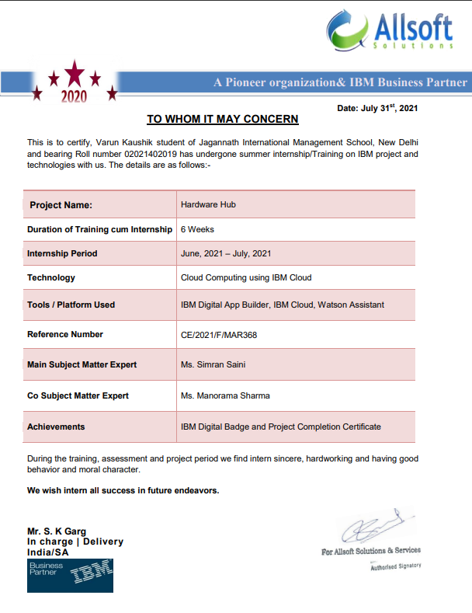

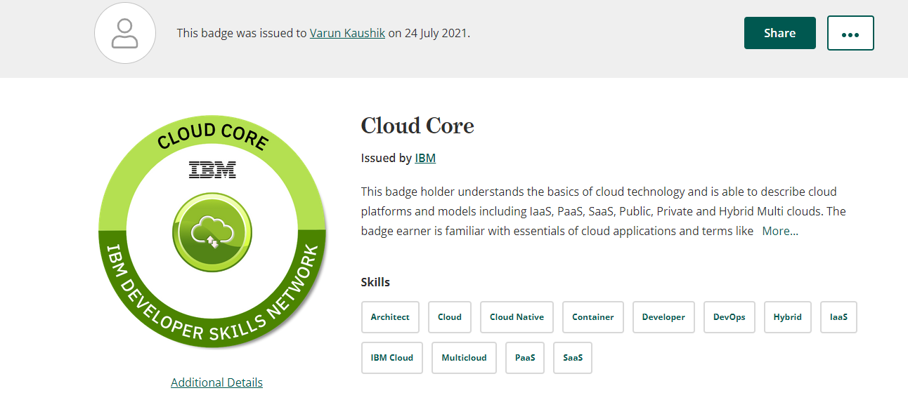
Certificate and Badge

